Slide 1

Data Visualization I
Pelin Atahan

Slide 2
Today’s Agenda
Data visualization
Its role in data analysis
Effective data visualization principles
Matplotlib
Simple plotting

Slide 3
The ability to take data—to be able to understand it, to process it, to extract value from it, to visualize it, to communicate it— that’s going to be a hugely important skill in the next decades."
Hal Varian, 2008

Slide 4
Definition
“The use of computer supported, interactive, visual representations of abstract data to amplify cognition.“ [Card et al, 1999]
“The representation and presentation of data to facilitate understanding.“[Kirk 2016]
Card, S. and Mackinley, J. and Shneiderman, B. Readings in Information Visualization: Using Vision to Think, Morgan Kaifman Publishers, 1999.
Kirk, A. Data Visualization: A Handbook for Data Driven Design. SAGE Publications 2016

Slide 5
Visualizing information allows us to see patterns and connections that matter.
We can design that information so that it makes sense, or it tells a story, or allows us to focus on the information that is important.
David McCandless
The Beauty of Data Visualization, 2010

Slide 6
Why Visualize?
To explore data
Provides understanding of data
Help show where to focus
To communicate insights and findings
Highlight what is important
Support recommendations - persuade others

Slide 7
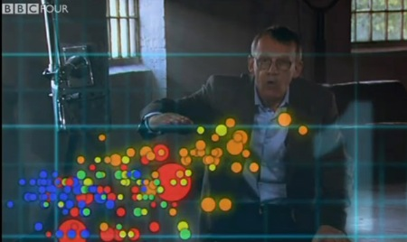
Hans Rosling- Joy of Stats
https://www.youtube.com/watch?v=jbkSRLYSojo

Slide 8
Purpose of Visualization
 | Exploratory |  | Declarative/Explanatory
Focus | Prototyping, iterating, interacting, automating |  | Documenting, designing
Goals | Discover, corroborate |  | Affirm

Slide 9
Context Matters
What am I trying to say?
Who is the audience?
Right data and right message based on context!

Slide 10
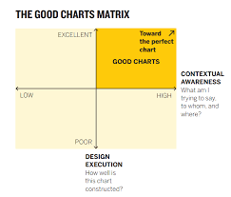
Good Charts Matrix
Source: Good Charts by Scott Berinoto

Slide 11
Use the Right Visual
Use the correct chart based on data, message and purpose

Slide 12
DESIGN PRINCIPLES

Slide 13
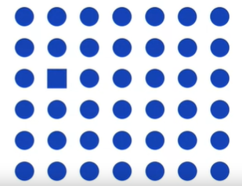
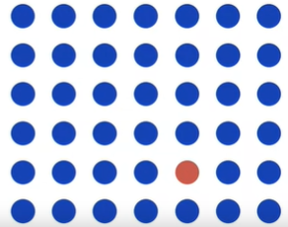
Visual Processing
We are programmed to detect differences

Slide 14
Conventions Expectations
Red is negative, but it sometimes means hot or active
Green is positive
Blue means cold or inactive
Lighter color shades are “emptier” or lower than darker ones.
Up is good
Down is bad
Hierarchies move from the top down

Slide 15
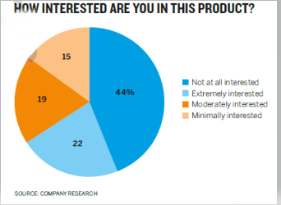
Product Survey

Slide 16
More Conventions
Like colors mean like things
Color saturation indicated higher and lower values
Categories are arranged and plotted from one extreme to another

Slide 17
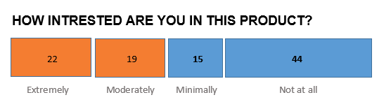
Product Survey Redesigned

Slide 18
Good Data Visualizations
Principle of Expressiveness – show what you need to, no more, no less
Principle of Effectiveness – use the most efficient method available to visualize your information
Source: Semiologie Graphique By Jacques Bertin (1967)

Slide 19
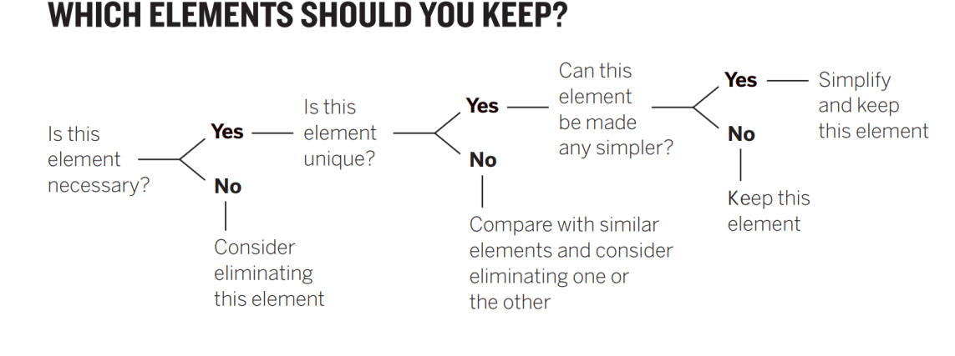
SIMPLIFY
Source: Good Charts by Scott Berinato

Slide 20
PERSUADE

Slide 21
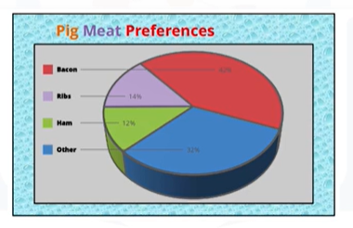
Pig Meat Preferences

Slide 22
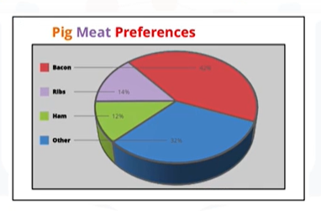
Pig Meat Preferences – background removed

Slide 23
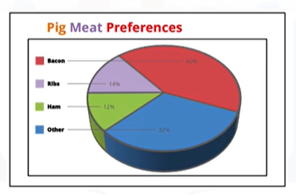
Pig Meat Preferences – background removed

Slide 24
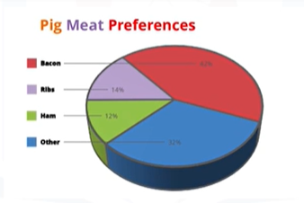
Pig Meat Preferences – borders removed

Slide 25
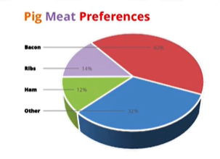
Pig Meat Preferences – legend removed

Slide 26
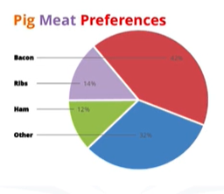
Pig Meat Preferences – 3D removed

Slide 27
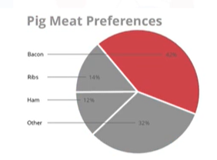
Pig Meat Preferences – colors removed

Slide 28
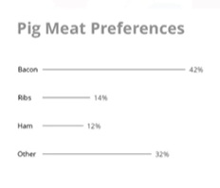
Pig Meat Preferences – pie chart removed

Slide 29
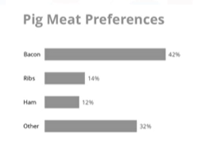
Pig Meat Preferences – bar chart added

Slide 30
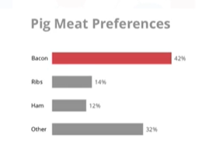
Pig Meat Preferences – color added

Slide 31
Compare

Slide 32
Data Visualization Principles
Goal of visualization
Audience
How humans detect patterns and make visual comparisons
Notes:
The principles are mostly based on research related to how humans detect patterns and make visual comparisons. The preferred approaches are those that best fit the way our brains process visual information.
When deciding on a visualization approach, it is also important to keep our goal in mind. We may be comparing a viewable number of quantities, describing distributions for categories or numeric values, comparing the data from two groups, or describing the relationship between two variables.
As a final note, we want to emphasize that for a data scientist it is important to adapt and optimize graphs to the audience. For example, an exploratory plot made for ourselves will be different than a chart intended to communicate a finding to a general audience.

Slide 33
Encoding data using visual cues
Approaches for encoding include:
aligned lengths, position, angles, area, brightness, and color hue.

Slide 34
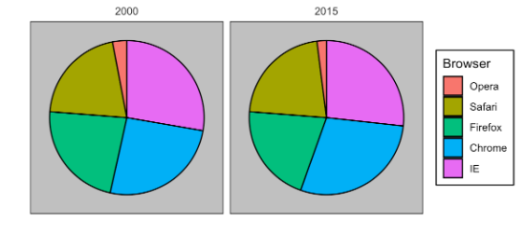
Browser Survey –Pie Chart
Notes:
Pie charts are a very bad way of displaying information. The eye is good at judging linear measures and bad at judging relative areas. A bar chart or dot chart is a preferable way of displaying this type of data.

Slide 35
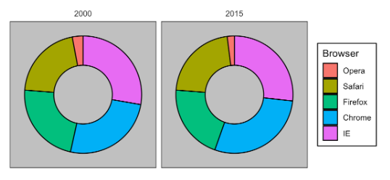
Browser Survey – Donut Chart

Slide 36
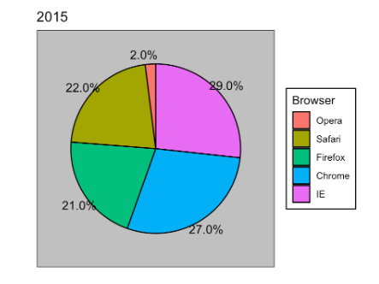
Browser Survey with Labels
Notes:
In general, when displaying quantities, position and length are preferred over angles and/or area.

Slide 37
Browser Survey Data
Browser | 2000 | 2015
Opera | 3 | 2
Safari | 21 | 22
Firefox | 23 | 21
Chrome | 26 | 29
IE | 28 | 27

Slide 38
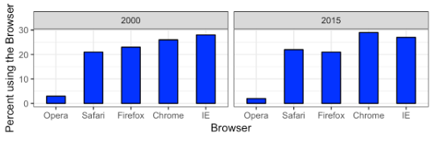
Browser Survey - Bar Chart 1

Slide 39
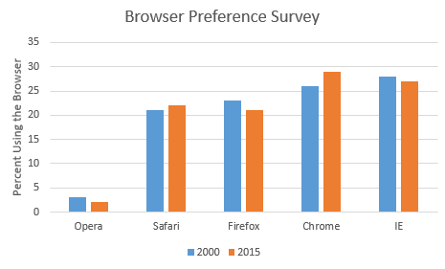
Browser Survey - Bar Chart 2

Slide 40
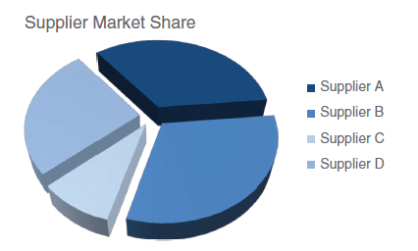
3D Pie Chart

Slide 41
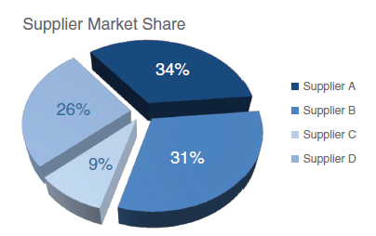
3D Pie Chart with Labels

Slide 42
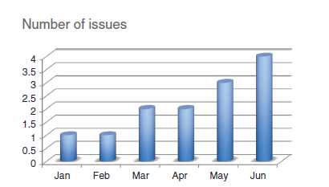
AVOID 3D

Slide 43
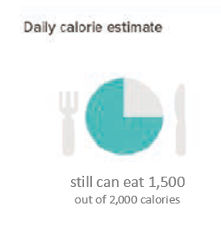
Good Pie Chart

Slide 44
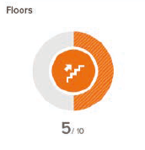
Good Donut Chart

Slide 45
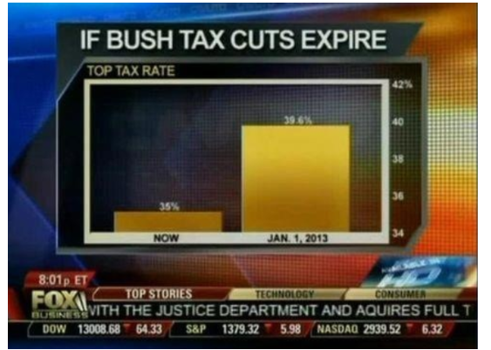
Non-Zero Baseline - Tax Rates
(Source: Fox News, via Flowing Data

Slide 46
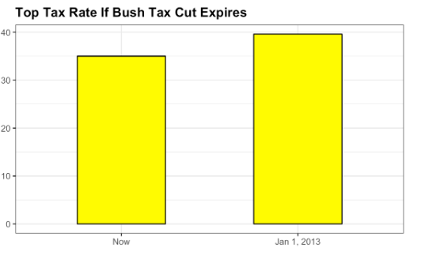
Zero Base Line -Tax Rates

Slide 47
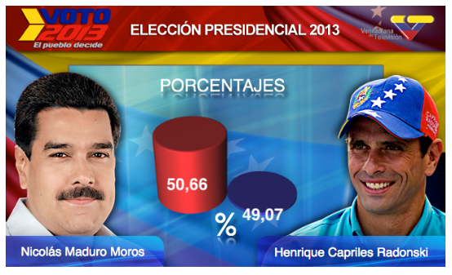
Venezuelan Presidential Elections
When creating a visual, remember that:
Less is more effective
Less is more attractive
Less is more impactive
( Source: Pakistan Today via Diego Mariano)

Slide 48
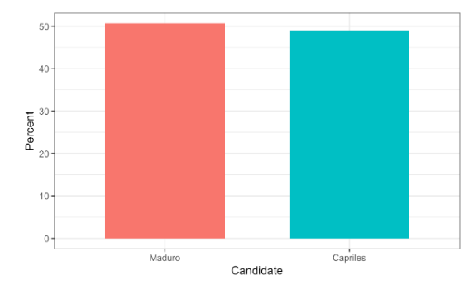
Venezuelan Presidential Elections Plot

Slide 49
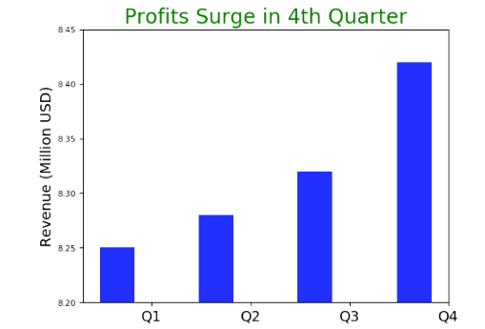
Non-Zero Base Line - Profits
Notes:
Y-axis is zoomed into just a small part of the graph
There is roughly 2% increase between Q1 and Q4
Font size on the y-axis seems to have been made intentionally small just so it’s harder to read
4th quarter is when holidays occur. Profits rise for many industries. A more honest plot might also plot prior year’s profits to compare against.

Slide 50
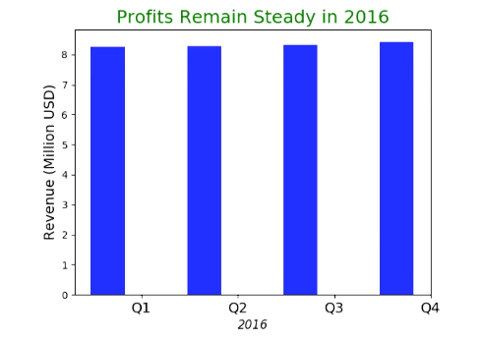
Zero Baseline - Profits
Notes:
When y-axis is set honestly. Revenue looks pretty steady over 2016.

Slide 51
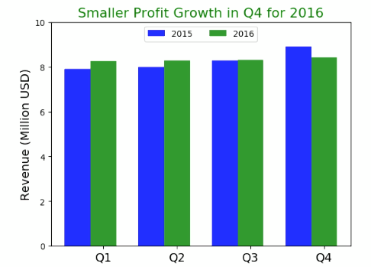
Zero Baseline with Historical Data
Notes:
Plotting previous year’s revenue makes the picture clearer.
There was a surge in profits in Q4 of 2015. 12% boost between Q1and Q4, which is less than 2% in 2016.
There is no surge in Q4 of 2016.
WE want to dive into the data more to figure out why we didn’t see a surge in 2016 (prior to presenting the results).

Slide 52
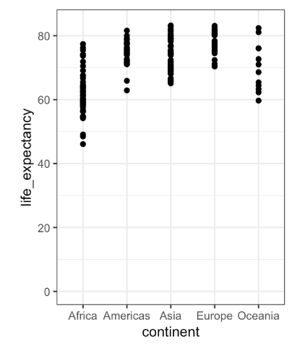
Using Position

Slide 53
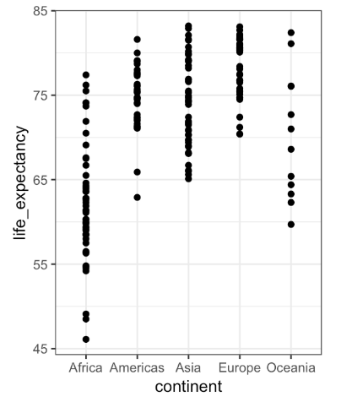
Using Position – Zero Baseline not Necessary

Slide 54
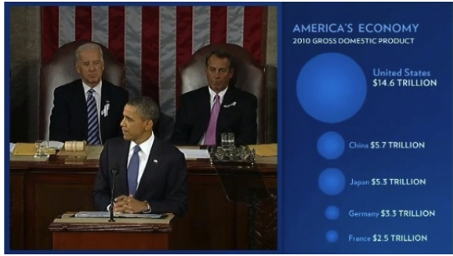
Do Not Distort Quantities
(Source: The 2011 State of the Union Address: Enhanced Version via Peter Aldhous )

Slide 55
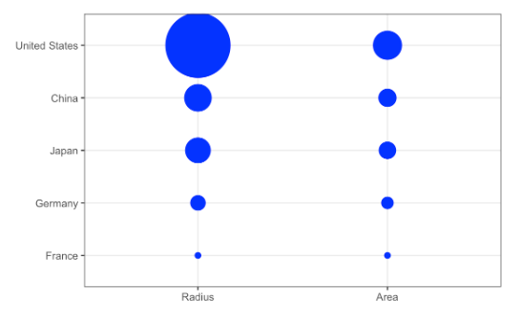
Actual quantities

Slide 56
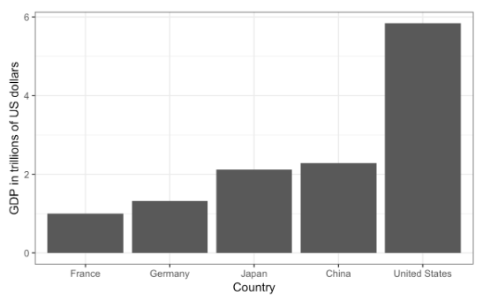
Quantity – Bar Chart

Slide 57
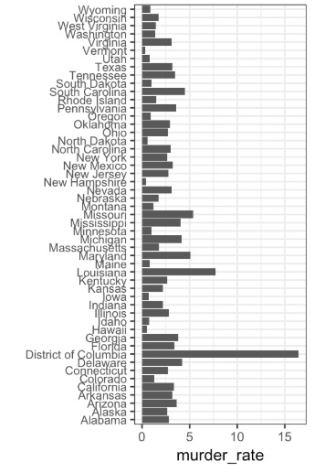
Ordering Categories - Murder Rates

Slide 58
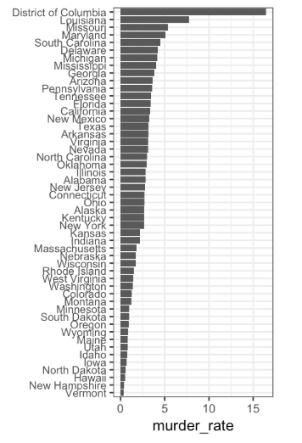
Ordering Categories – Appropriate Ordering

Slide 59
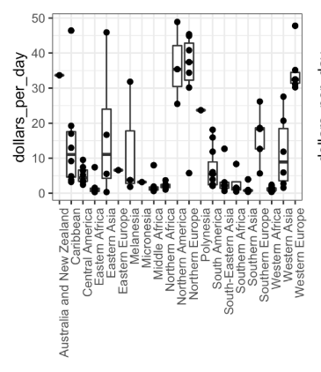
Ordering Categories – Income Distribution

Slide 60
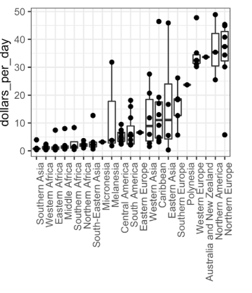
Ordering Categories – Appropriate Ordering

Slide 61
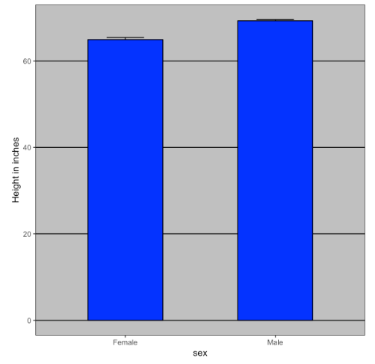
Average Height with Standard Error

Slide 62
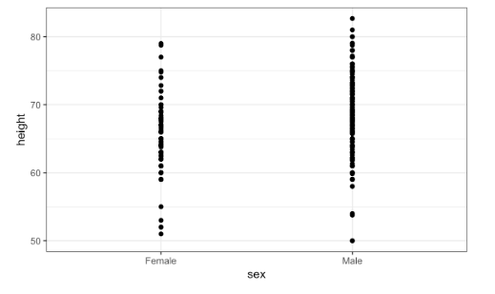
Height Data

Slide 63
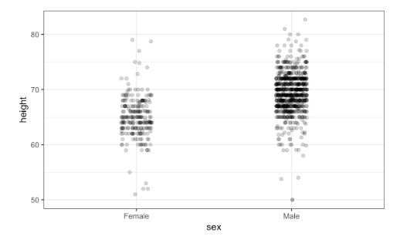
Height Data with Jitter

Slide 64
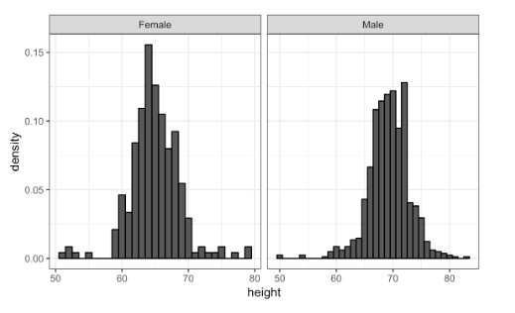
Ease comparisons – Use Common Axis

Slide 65
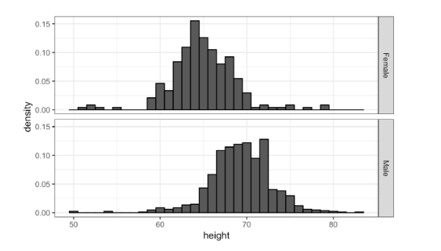
Align plots vertically to see horizontal changes

Slide 66
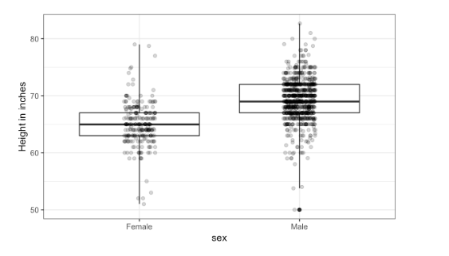
Align plots horizontally to see vertical changes

Slide 67
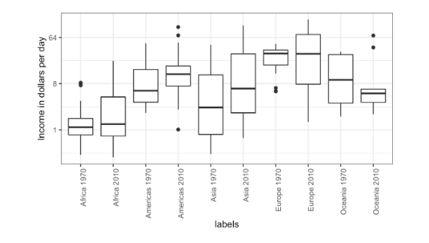
Use Color

Slide 68

Colored Box Plot

Slide 69
Consider the Colorblind
Around 8 to 10% of men and 0.5% of women have color vision deficiency
Be careful when using red-green-brown-orange together
Use colorblind friendly pallette

Slide 70

Good Plot

Slide 71
Matplotlib
Most widely used data visualization library in Python
Best for two-dimensional non-interactive plots.
Easy to produce quick plots
Developed by John Hunter a neurobiologist for electrochortiograhpy analysis
“Matplotlib tries to make easy things easy and hard things possible.”
-https://matplotlib.org/

Slide 72
MatplotLib Architecture
Has three layers : Backend, Artist and Scripting Layer
Scripting layer – pyplot interface

Slide 73
Types of Charts

Slide 74
Line Plot
Best use case – to visualize the change in the value of a continuous variable over time

Slide 75
Area Plot
An extension of the line plot
Depicts accumulated totals using numbers or percentages over time.
Commonly used to compare two or more quantities

Slide 76
Histogram
Explore data
Represents the frequency distribution of numeric data
Partitions the spread of the numeric data into bins,
Assigns each datapoint to a bin,
Counts the number of datapoints in each bin
Vertical axis is the frequency or the number of datapoints in each bin.

Slide 77




Histogram- Example

Slide 78
Bar Charts
Length of bars represent the magnitude/size of variable
Usually represent numerical or categorical variables grouped in intervals
Can be vertical or horizontal

Slide 79
Scatterplot
Useful for showing the relationship between two things
Allows to encode data simultaneously on x-axis and y-axis to see whether and what kind of relationship exists

Slide 80
Other Python Libraries (1)
Specialized statistical plots, like automatically fitting a linear regression with confidence interval or like scatter plots color-coded by category
seaborn: builds on top of Matplotlib and it can also be used as a replacement for matplotlib just for an easier way to specify color palettes and plotting aesthetics

Slide 81
Other Python Libraries (2)
Interactive map visualization
folium: Creates HTML pages that include the Leaflet.js javascript plotting library to display data on top of maps.
plotly: supports color-coded country/world maps embedded in the Jupyter Notebook.

Slide 82
Other Python Libraries (3)
Interactive plots, that work in the Jupyter Notebooks but also can be exported as Javascript to work standalone on a webpage.
bokeh: maintained by Continuum Analytics, the company behind Anaconda
plotly: is both a library and a cloud service where you can store and share your visualizations (has free/paid accounts)

Slide 83
Other Python Libraries (4)
Realtime plots that update with streaming data, even integrated in a dashboard with user interaction.
bokeh plot server: it is part of Bokeh but requires to launch a separate Python process that takes care of responding to events from User Interface or from streaming data updates.
3D plots. Though are not easy to interpret, first consider if a combination of 2D plots could provide a better insight into the data
mplot3d: Matplotlib tookit for 3D visualization

